Slide 1

SPORTS ANALYSIS

Slide 2

Project Explanation
Power Bi Statement
EDA Problem Statement

Slide 3
Introduction of Project
This is a data Analytics project based on Olympic Games data from 1896 to 2016. In this Olympic Games dataset is a comprehensive collection of information detailing the history, sports, participants, and locations of the Olympics. It encompasses interconnected tables covering sports, events, host cities, games names and medal awards. This dataset offers valuable insights into the evolution of the Olympics. . This project is divided into two parts one is working with Power BI and the other one is EDA work with SQL and Excel. These tool help to find different insight in the Dataset.

Slide 4
Objective
The objective of this project is to analyze the Olympic Games dataset from 1896 to 2016 using Power BI, SQL, and Excel to uncover trends, geographic distribution, country performance and the evolution of sports and events. This will provide valuable insights into the history and impact of the Olympics.
Analysis Scope
The analysis scope includes examining trends, geographic distribution, country performance, medal distribution and the evolution of sports and events in the Olympic Games from 1896 to 2016 using Power BI, SQL, and Excel

Slide 5
Goal
The goal is to leverage Power BI, SQL, and Excel to analyze the Olympic Games dataset, uncovering insights into trends, geographic distribution, and country performance, enhancing understanding of the Olympics' history and its global impact.

Slide 6
Dataset Description
The dataset here is a comprehensive collection of information about the Olympic Games, offering a detailed view of various aspects related to this prestigious international sporting event. It encompasses data from multiple interconnected tables, providing valuable insights into the history, sports, participants, and locations of the Olympic Games.
Table Explanations
Sport Table
This table contains a comprehensive list of all sports featured in the Olympics, covering both the summer and winter editions. Each sport is further categorized into specific events, catering to a wide range of athletic disciplines.
Event Table
The Event table offers detailed information about the various events held within each sport. Events are categorized based on gender, with separate entries for Men's, Women's, and Mixed events.
City Table
This table provides an extensive list of cities from around the world that have hosted or participated in the Olympic Games over the years.
Games Table
The Games table records every instance of the Olympic Games since its inception in 1896. It includes essential details such as the year in which the Games were held, as well as distinguishing between Summer and Winter Olympics.

Slide 7
Games City Table
This joining table establishes the relationship between the Games and City tables, capturing instances where the Olympic Games were jointly hosted by multiple cities, as seen in the case of the 1956 Olympics held in both Melbourne and Stockholm.
NOC Region Table
This table consists of NOC codes, representing National Olympic Committees, and their corresponding countries. It acts as a reference to identify the countries participating in the Olympic Games.
Person Table
The Person table records information about individuals who have competed in the Olympics. It includes their names, gender, height, and weight, with height and weight data remaining consistent across different Olympic editions.
Person Region Table
This joining table establishes connections between individuals and the countries they represented while competing in the Olympics. It accommodates scenarios where a person may have competed for multiple countries in different Olympic Games.
Games Competitor Table
This table serves as a joining table, linking individuals to specific Olympic Games, showcasing the participants and their involvement in each event.
Medal Table
A small table listing the different types of medals awarded at the Olympics, including Gold, Silver, Bronze, and N/A (indicating no medal).
Competitor Event Table
This table represents the largest one, providing crucial details about the combination of competitors, the events they participated in, and the medals they received, if any.

Slide 8
Power Bi Analysis
Find the Insights from Power Bi Report

Slide 9
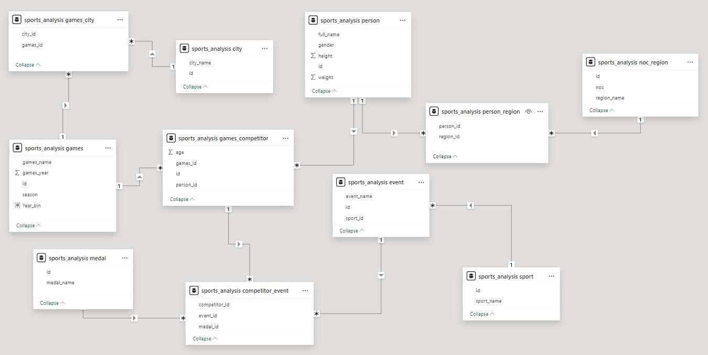
ER Diagram

Slide 10
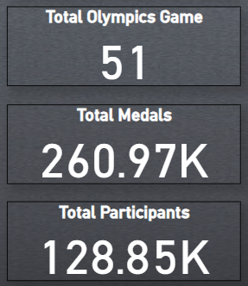
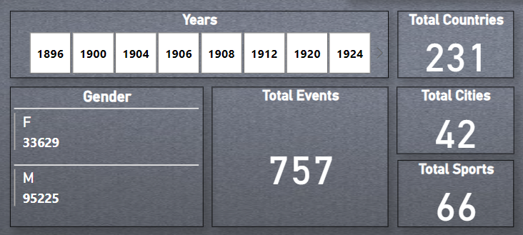
SPORTS ANALYSIS
KPI
There are some important KPI’s that are present in the Olympic Games Dataset.

Slide 11
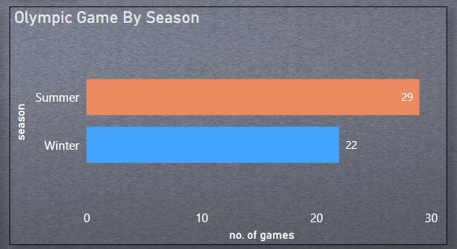
SPORTS ANALYSIS
1. How many Olympic Games have been held in each season (Summer vs. Winter)?
There are 29 Olympic games played in Summer and 22 Olympic games played in Winter since 1869 to 2016.

Slide 12
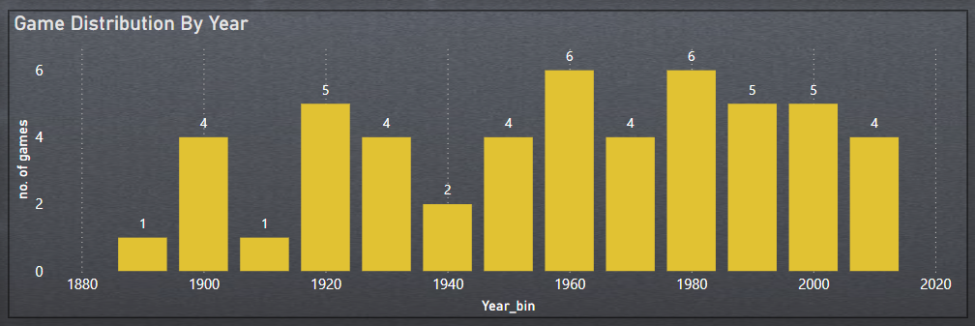
SPORTS ANALYSIS
2. What is the distribution of games across different decades?
Here , We create a column chart to analyze the distribution of Olympic Games across different decades.

Slide 13
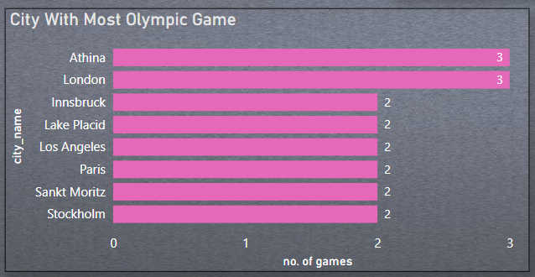
SPORTS ANALYSIS
3.Which cities have hosted the most Olympic Games?
Athina and London are the cities had hosted the most Olympic games.

Slide 14
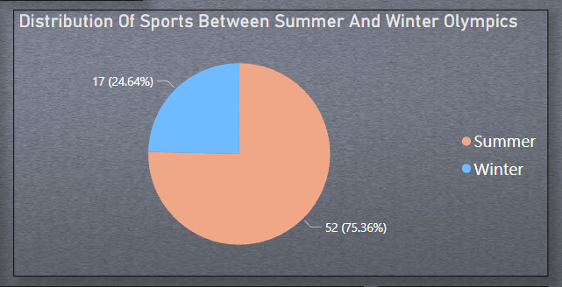
SPORTS ANALYSIS
4. What is the distribution of sports between Summer and Winter Olympics?
There are 17 Sports played in Winter and 52 sports played in Summer.

Slide 15
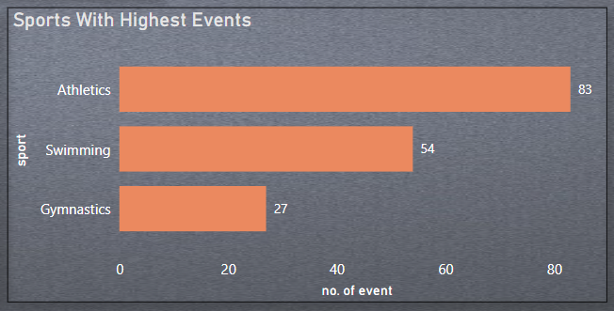
SPORTS ANALYSIS
5. Which sports have the highest number of events in the Olympics?
“Athletics” , ‘”Swimming” and ”Gymnastics” are sports that has a highest events in Olympic Games.

Slide 16
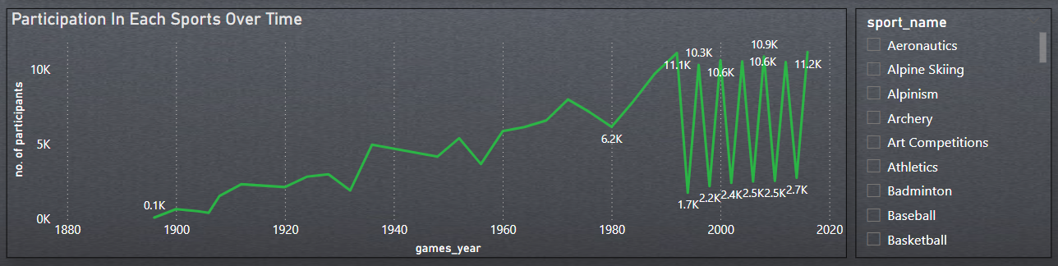
SPORTS ANALYSIS
6. How has the participation in each sport evolved over time?
Participation in sports increased steadily from 1900 to 1980, surged to 11.1K by 2000, then fluctuated between 1.7K and 11.2K participants, peaking at 11.2K by 2016. I use Sports filter to analyze different Sports Participation over time.

Slide 17
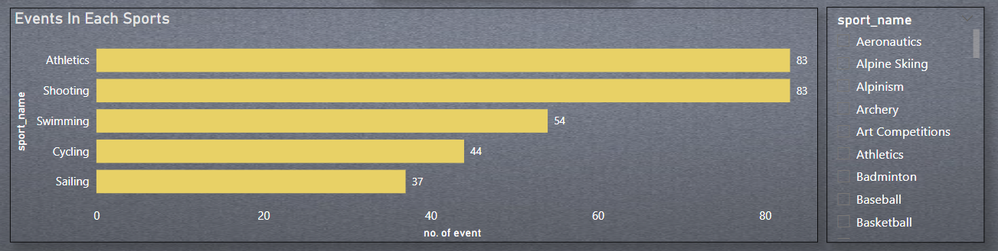
SPORTS ANALYSIS
7. How many events are there in each sport?
Athletics and Shooting each have 83 events. Swimming follows with 54 events, Cycling has 44 events, and Sailing includes 37 events. These sports feature a high number of events, showcasing their diverse competition categories.

Slide 18
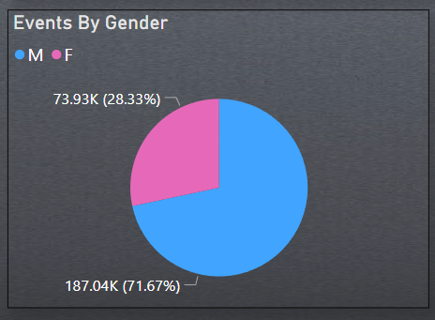
SPORTS ANALYSIS
8. What is the distribution of events by gender (Men, Women, Mixed)?
The distribution of Events by Gender in all Olympic Games. Total Males Participants is 187.04K and Total Women Participants is 73.93K.

Slide 19
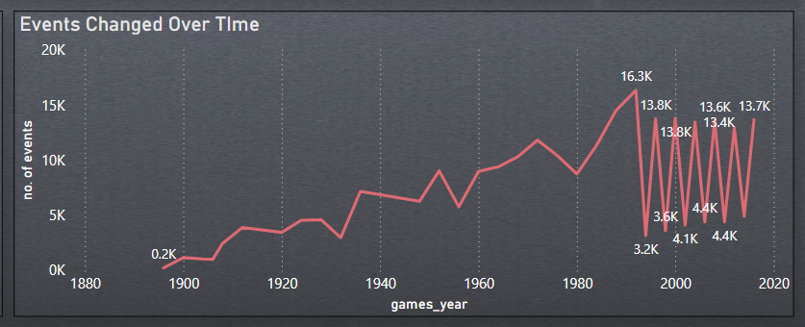
SPORTS ANALYSIS
9. How has the number of events changed over time?
The number of events has generally increased over time, starting from 0.2K events in 1900, with fluctuations and a notable peak of 16.3K around 1990. The trend shows periodic fluctuations between 3.2K and 13.7K after 2000.

Slide 20
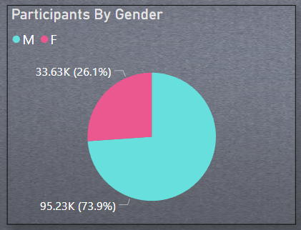
SPORTS ANALYSIS
10.What is the distribution of participants by gender?
The distribution of Participants by Gender in all Olympic Games. Total Male Participants is 95.23K and Total Women participants is 33.63K.

Slide 21
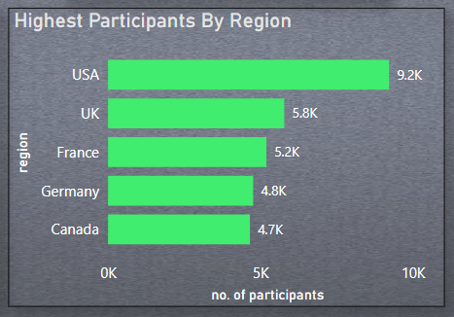
SPORTS ANALYSIS
11. Which countries have the highest number of participants in the Olympics?
The countries with the highest number of participants in the Olympics are the USA (9.2K), the UK (5.8K), France (5.2K), Germany (4.8K), and Canada (4.7K), showcasing significant contributions from these regions.

Slide 22
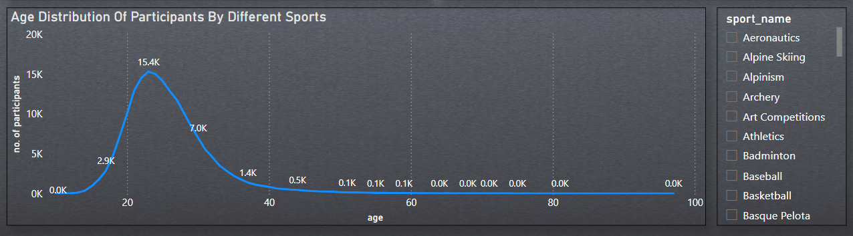
SPORTS ANALYSIS
12. How does the age distribution of participants vary across different games?
This graph shows the age distribution of participants in various sports. Participation is highest among young adults (20-40 years old) for most sports. I use filter in sports to analyze the Age distribution in different sports.

Slide 23
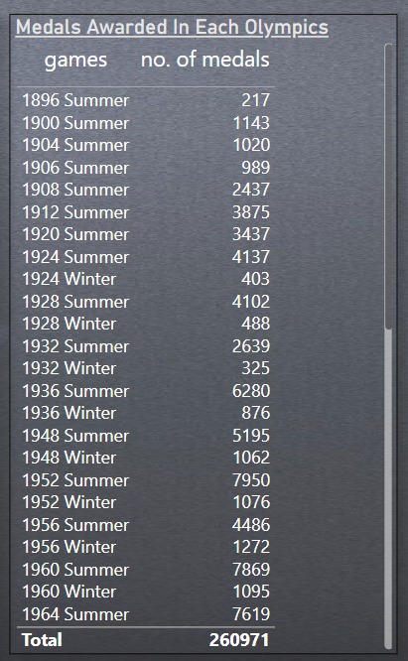
SPORTS ANALYSIS
13. How many medals have been awarded in each Olympics?
The number of medals awarded at the Olympic Games has grown significantly since 1896. The table shows a dramatic increase. The total medals distributed in all Olympic Games is 260971.

Slide 24
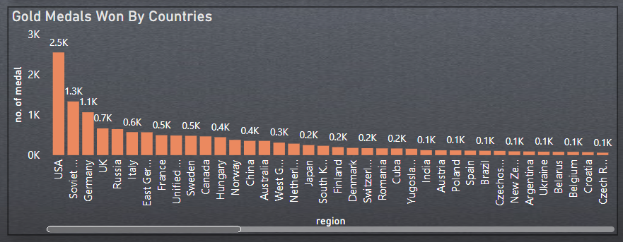
SPORTS ANALYSIS
14. Which countries have the highest number of gold medals?
This bar chart reveals the top countries for total gold medals. The United States dominates with the most Gold Medal, followed by the Soviet Union and Germany.

Slide 25
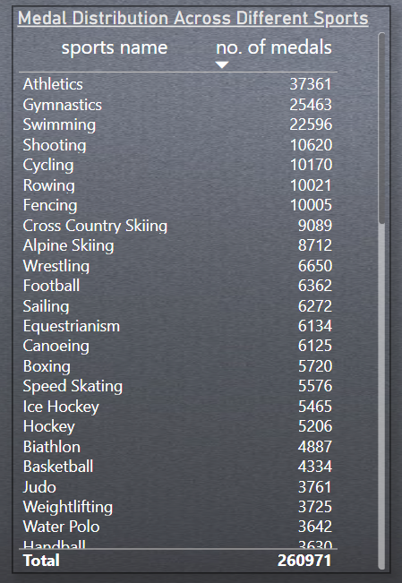
SPORTS ANALYSIS
15. How does the medal distribution vary across different sports?
This table shows the distribution of medals across different sports at the Olympics. Athletics leads the way with over 37,361 medals awarded, followed by Gymnastics and Swimming. The total medals distributed in all Olympic Games is 260971.

Slide 26
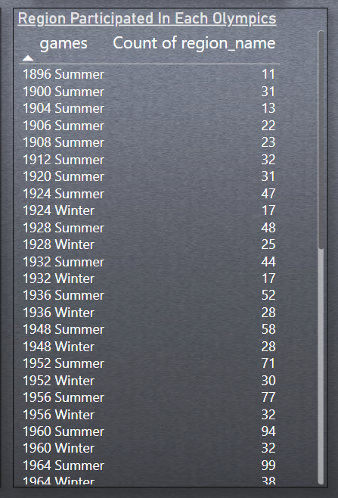
SPORTS ANALYSIS
16. How many regions or NOCs participate in each Olympic Games?
The number of participating regions steadily increased over the years.

Slide 27
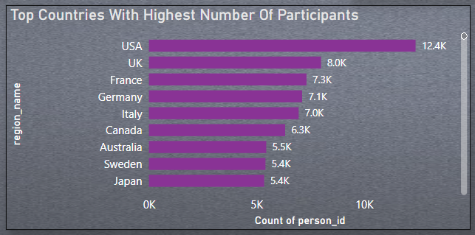
SPORTS ANALYSIS
17. Which regions have the highest number of participants in the Olympics?
This bar graph illustrates the top countries with the highest number of participants at the Olympics. The United States leads with over 12.4K participants, followed by the United Kingdom, France, and Germany.

Slide 28
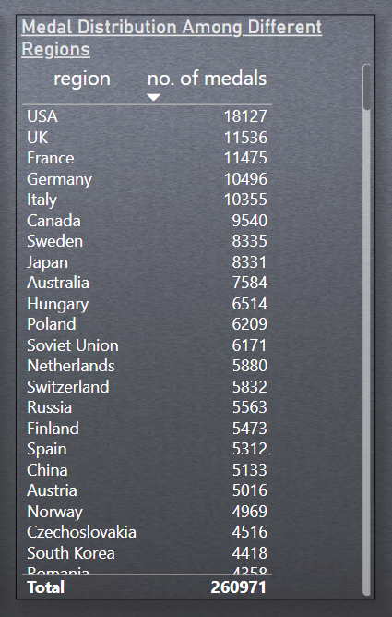
SPORTS ANALYSIS
18. What is the distribution of medals among different regions?
This table displays the medal distribution among various regions. The United States holds the most medals with over 18,127, followed by the United Kingdom, France, and Germany.

Slide 29
Exploratory Data Analysis Problem Statements

Slide 30
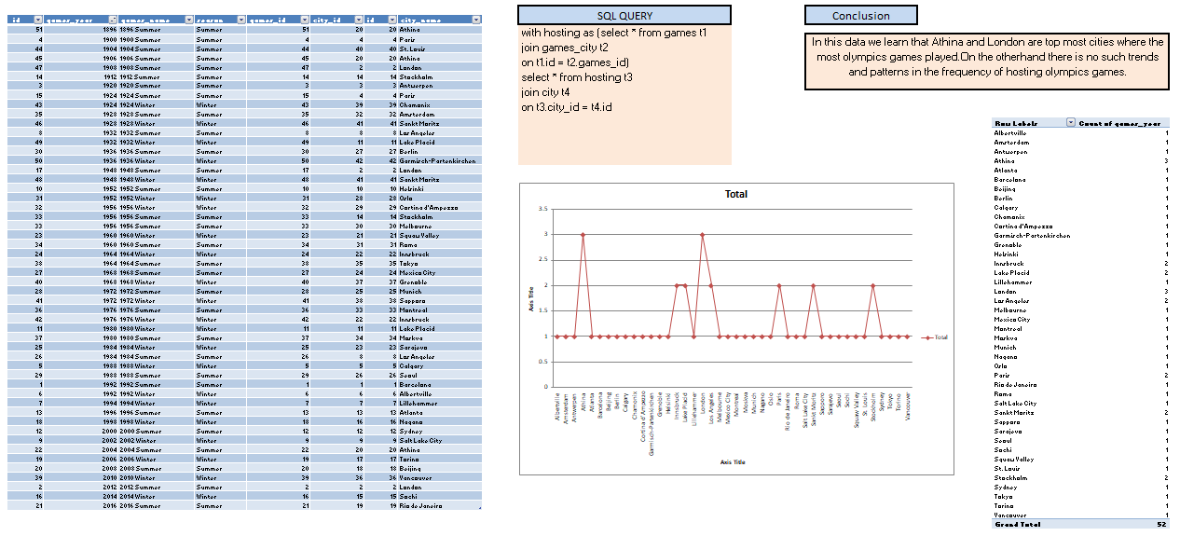
1. Are there any trends or patterns in the frequency of hosting Olympic Games?

Slide 31
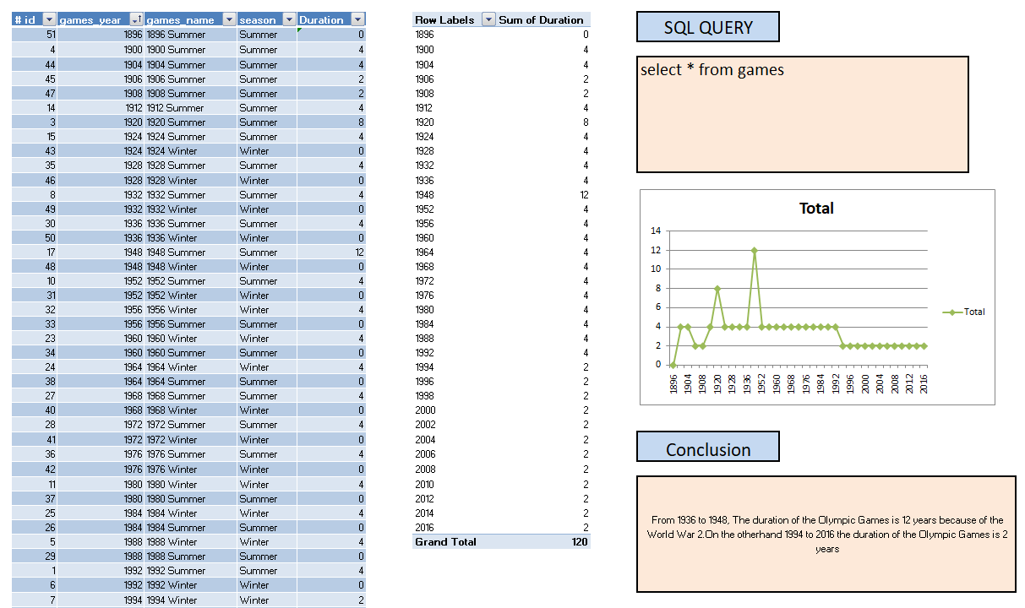
2. How has the duration of Olympic Games changed over time?

Slide 32
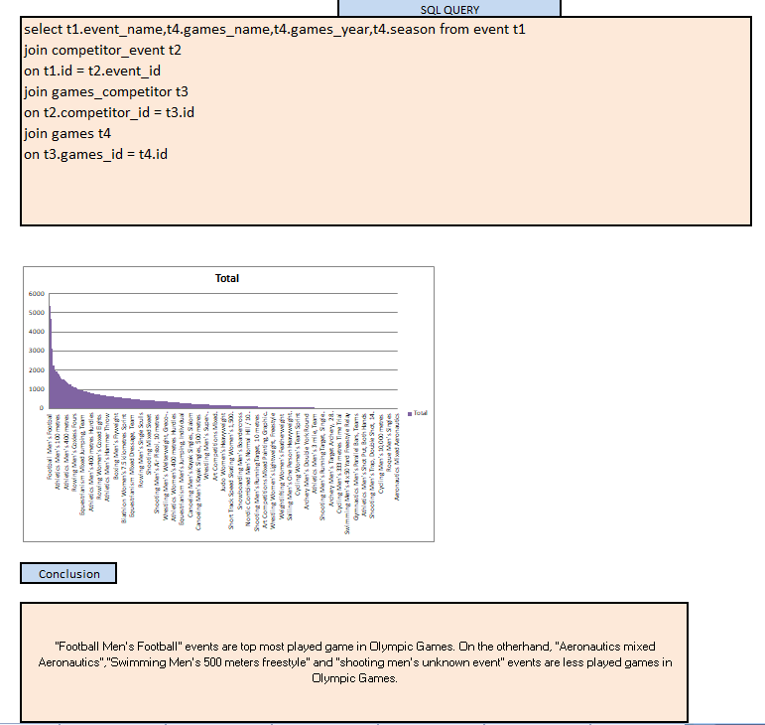
3.Are there any notable events or occurrences associated with specific Olympic Games?

Slide 33
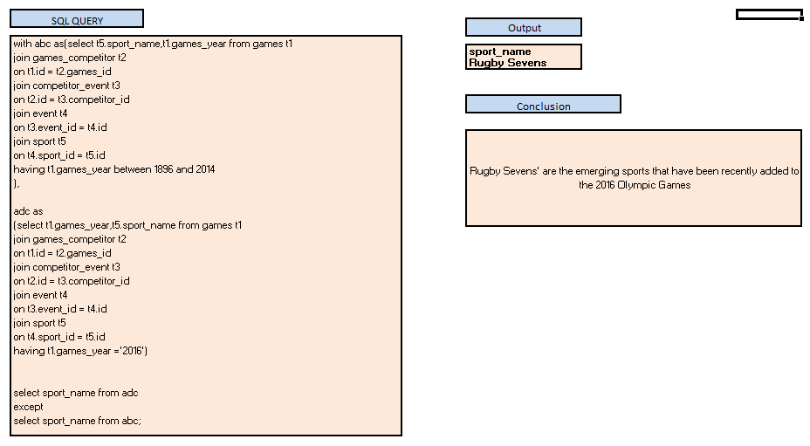
4. Are there any emerging sports that have been recently added to the Olympics?

Slide 34
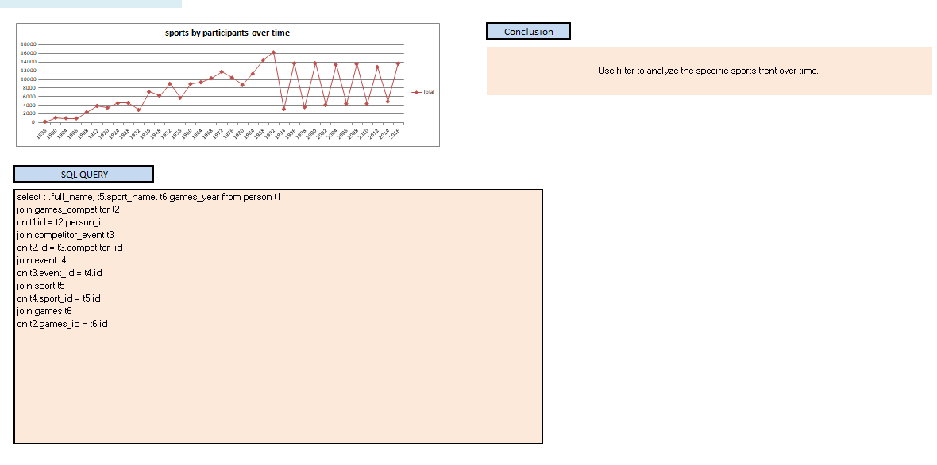
5. How has the popularity of certain sports changed over the years?

Slide 35
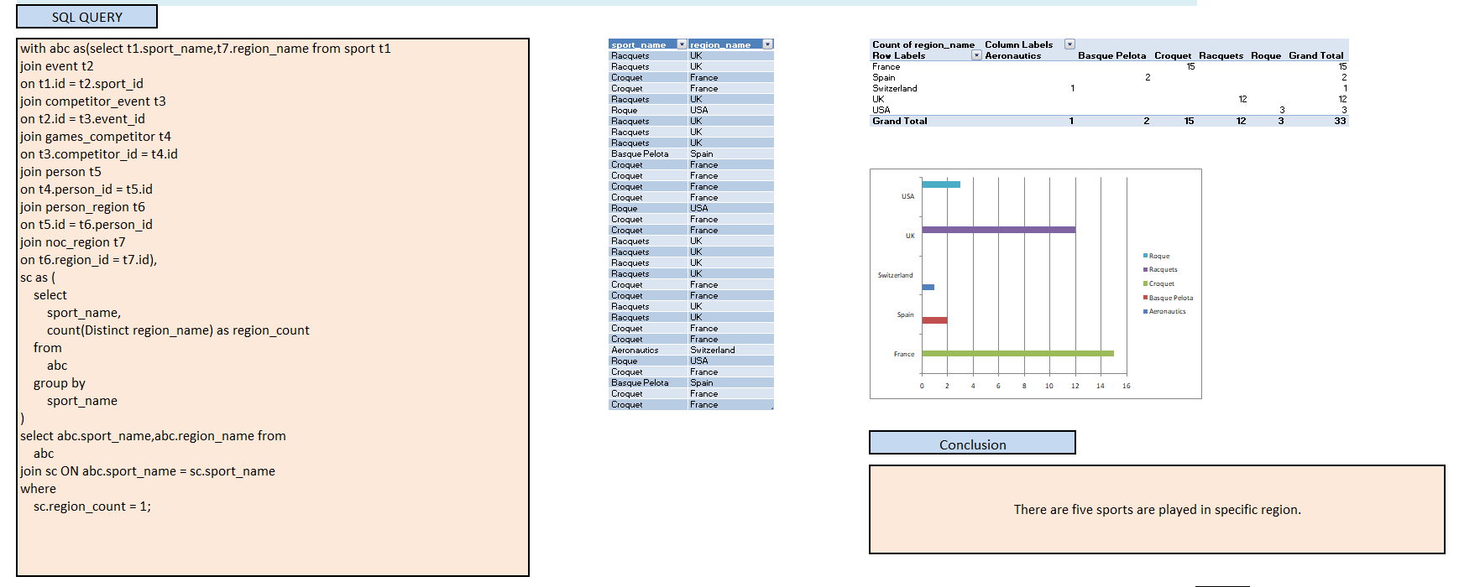
6. Are there any sports that are specific to a particular region or culture?

Slide 36
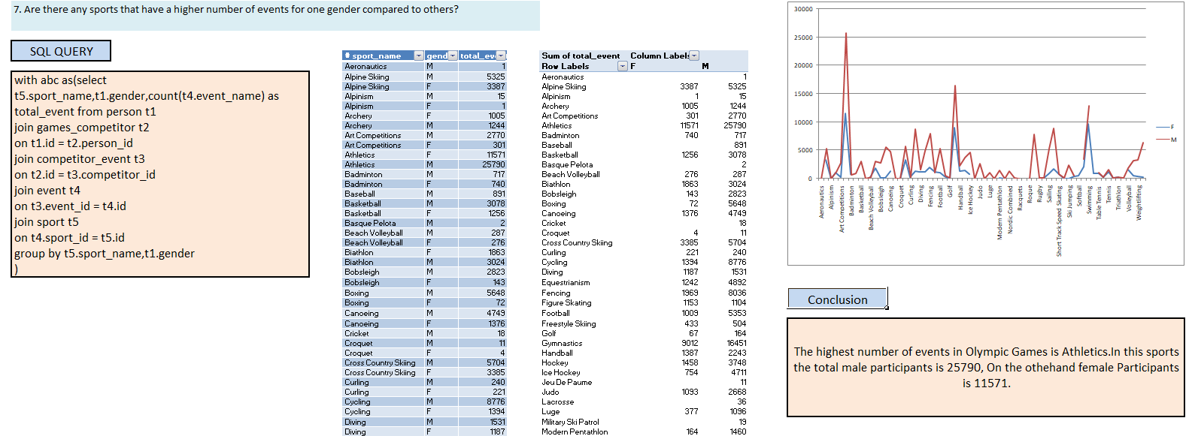
7. Are there any sports that have a higher number of events for one gender compared to others?

Slide 37
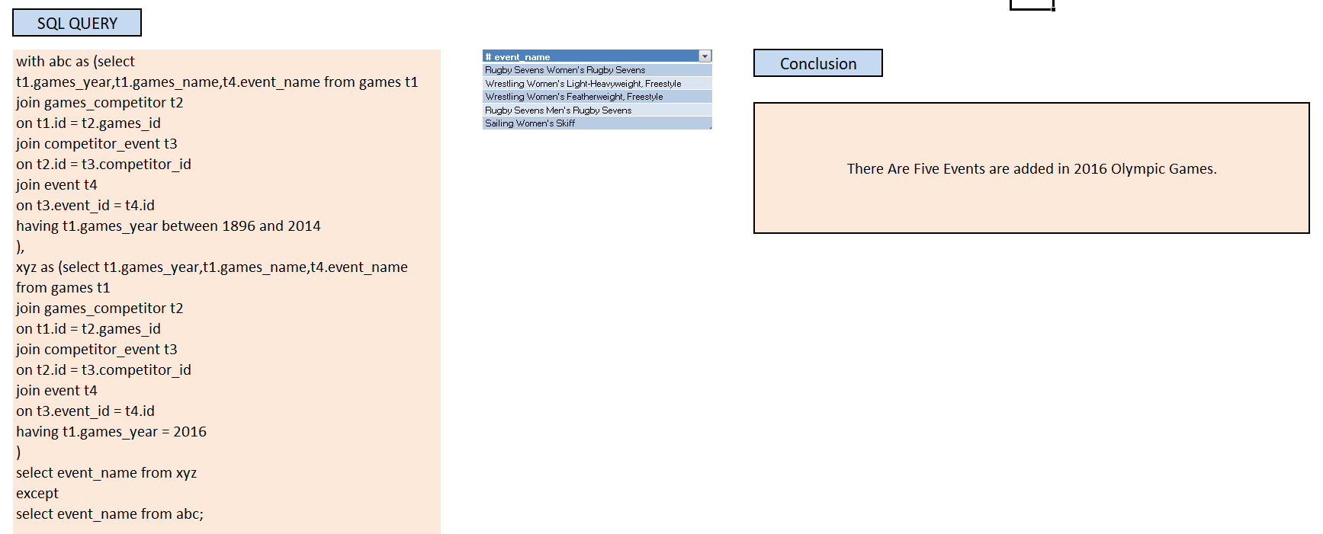
8. Are there any new events that have been introduced in recent editions of the Olympics?

Slide 38
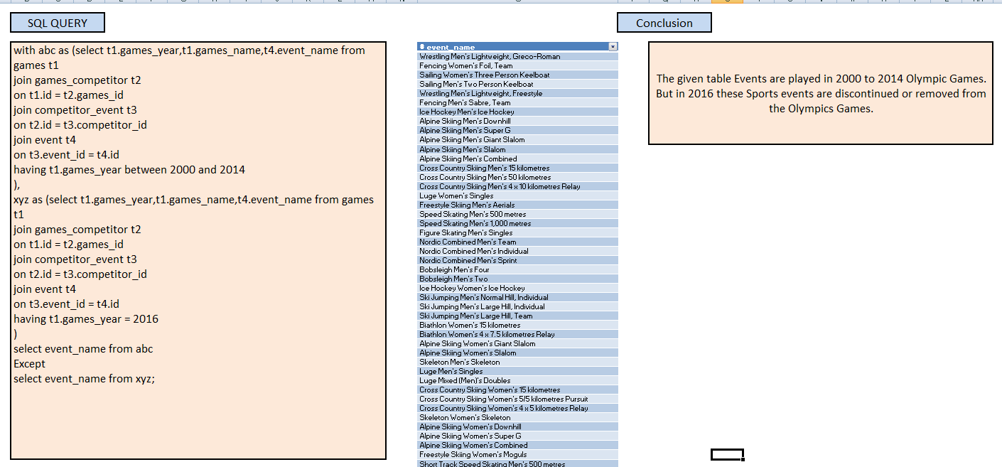
9. Are there any events that have been discontinued or removed from the Olympics?

Slide 39
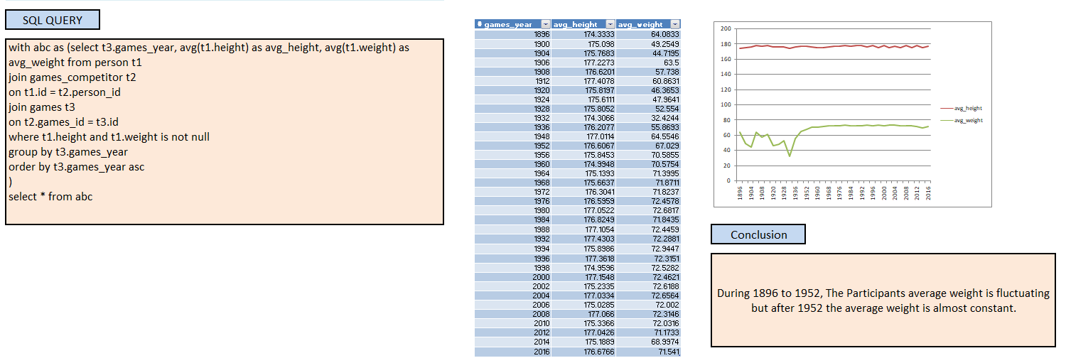
10. Are there any notable trends in the height and weight of participants over time?

Slide 40
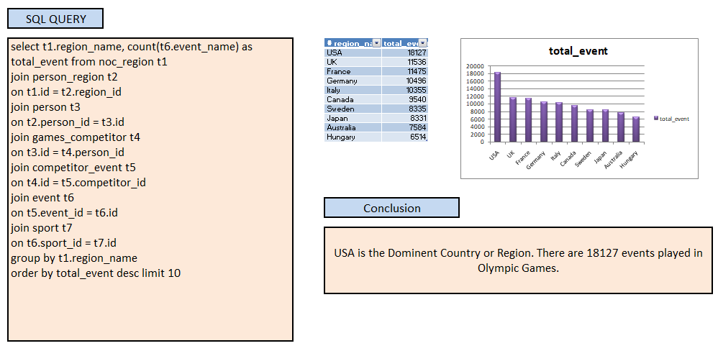
11. Are there any dominant countries or regions in specific sports or events?

Slide 41
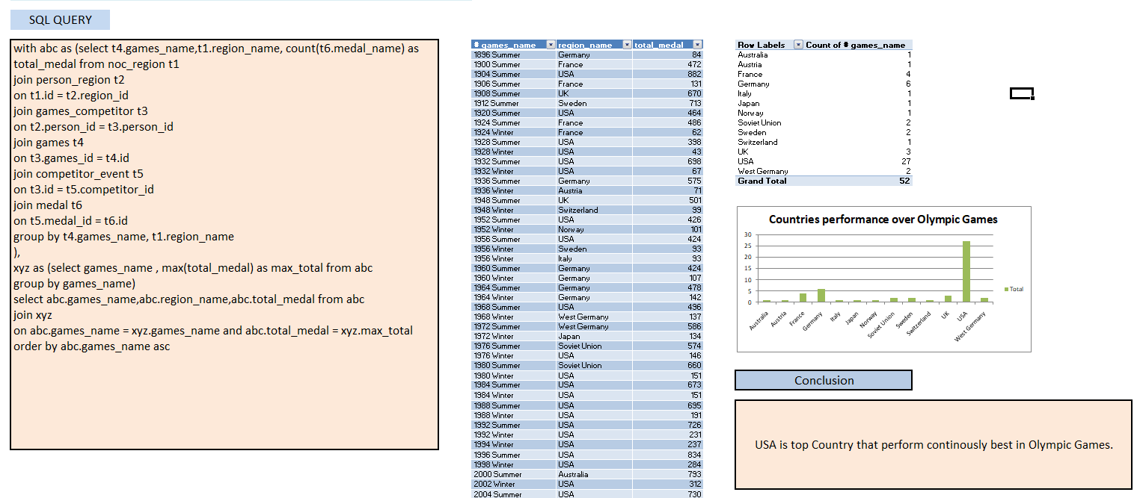
12. Are there any countries that consistently perform well in multiple Olympic editions?

Slide 42
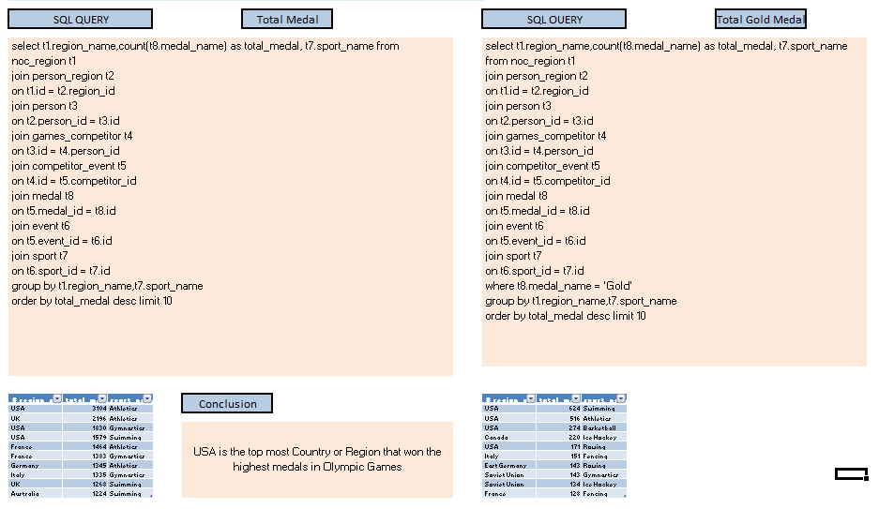
13. Are there any sports or events that have a higher number of medalists from a specific region?

Slide 43
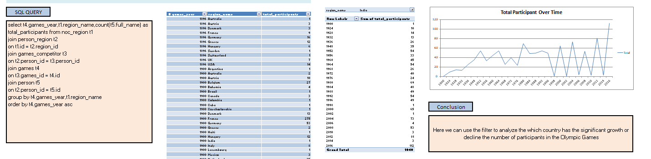
14. Are there any regions that have experienced significant growth or decline in Olympic participation?

Slide 44
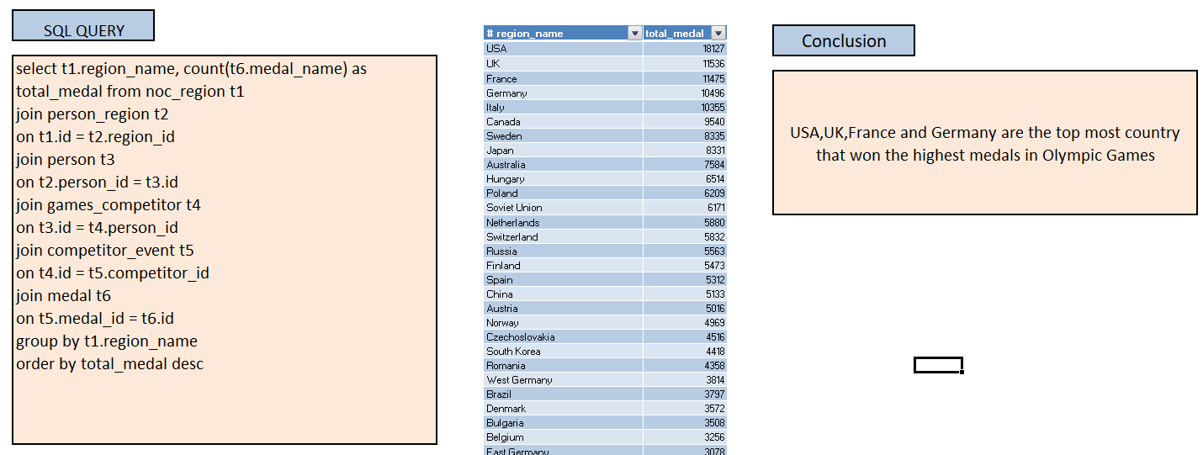
14. Are there any regions that have experienced significant growth or decline in Olympic participation?

Slide 45
15. Are there any regions that have had a notable impact on the overall medal tally?

Slide 46
THANK YOU…

